Slide 1
Implementing IPv6 with OSPF and Other Routing Protocols
BSCI Module 8 – Lesson 4

Slide 2
Objectives
Describe how OSPF for IPv6 works
Explain the similarities and differences between OSPF for IPv6 to OSPFv2
Describe the differences between OSPF LSA types used with IPv4 and IPv6
Explain the configuration modes and Cisco IOS attributes specific to OSPFv3
Explain how to configure OSPFv3
Explain how to verify OSPFv3

Slide 3

IPv6 Routing Protocols

Slide 4
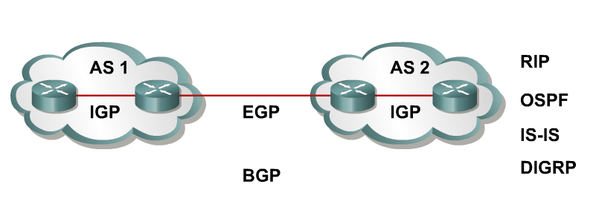
IPv6 Routing Protocols
IPv6 routing types:
Static
RIPng (RFC 2080)
OSPFv3 (RFC 2740)
IS-IS for IPv6
MP-BGP4 (RFC 2545/2858)
EIGRP for IPv6
ipv6 unicast-routing command is required to enable IPv6 before any routing protocol configured.
Notes:
Like IP version 4 (IPv4) classless interdomain routing (CIDR), IPv6 uses the same “longest-prefix match” routing. Recent protocol versions handle longer IPv6 addresses and different header structures. Currently the updated routing protocols shown in the figure are available.
Static routing with IPv6 is used and configured in the same way as with IPv4. There is an IPv6 specific requirement per RFC 2461: a router must be able to determine the link-local address of each of its neighboring routers in order to ensure that the target address of a redirect message identifies the neighbor router by its link-local address. This basically states that it is not recommended to use a global unicast address as a next-hop address with routing.
The IOS global command for IPv6 is ipv6 unicast-routing.

Slide 5
RIPng
Same as IPv4:
Distance-vector, radius of 15 hops, split-horizon, and poison reverse
Based on RIPv2
Updated features for IPv6:
IPv6 prefix, next-hop IPv6 address
Uses the multicast group FF02::9, the all-rip-routers multicast group, as the destination address for RIP updates
Uses IPv6 for transport
Named RIPng
Notes:
RIPng (RFC 2080) is referred to as the Routing Information Protocol next generation (RIPng). RIPng is a distance-vector routing protocol with a limit of 15 hops, which uses split-horizon and poison reverse to prevent routing loops.
IPv6 update features include:
Based on IPv4 Routing Information Protocol version 2 (RIPv2) and similar to RIPv2
Uses IPv6 for transport
IPv6 prefix, next-hop IPv6 address
Uses the multicast group FF02::9, the all-RIP-routers multicast group, as the destination address for RIP updates
Updates are sent on User Datagram Protocol (UDP) port 521

Slide 6
Integrated Intermediate System-to-Intermediate System (IS-IS)
Same as for IPv4.
Extensions for IPv6:
2 new type-length-values (TLV):
IPv6 reachability (with 128 bits prefix)
IPv6 interface address (with 128 bits)
New protocol identifier
Not yet an IETF standard
Notes:
IS-IS is the same as IPv4 with some extensions added:
Two new Types, Lengths, Values (TLVs)
IPv6 reachability
IPv6 interface address
New protocol ID

Slide 7
Multiprotocol Border Gateway Protocol (MP-BGP) (RFC 2858)
Multiprotocol extensions for BGPv4:
Enables protocols other than IPv4.
New identifier for the address family.
IPv6 specific extensions:
Scoped addresses: NEXT_HOP contains a global IPv6 address and potentially a link-local address (only when there is a link-local reachability with the peer).
NEXT_HOP and NLRI (Network Layer Reachability Information) are expressed as IPv6 addresses and prefix in the multiprotocol attritubes.
Notes:
To make Border Gateway Protocol version 4 (BGP4) available for other network layer protocols, RFC 2858 (which obsoletes RFC 2283) defines multiprotocol extensions for BGP4.
MP-BGP is used to enable BGP4 to carry information of other protocols, for example, Multiprotocol Label Switching (MPLS) and IPv6.

Slide 8
OSPF Version 3 (OSPFv3) (RFC 2740)
Similar to OSPF for IPv4:
Same mechanisms, but a major rewrite of the internals of the protocol
Updated features for IPv6:
Every IPv4-specific semantic is removed
Carry IPv6 addresses
Link-local addresses used as source
IPv6 transport
OSPF for IPv6 is currently an IETF proposed standard
Notes:
The protocol implementation for IPv6 includes:
Based on OSPF version 2 (OSPFv2), with enhancements
Distributes IPv6 prefixes
Runs directly over IPv6
OSPFv3 and OSPFv2 are independent processes, run as “Ships in the night”
This implementation adds these IPv6-specific attributes:
128-bit addresses
Link-local address
Multiple addresses and instances per interface
Authentication (now uses IPsec)
OSPFv3 runs over a link rather than a subnet

Slide 9
Self Check
What global configuration command is used to enable IPv6 before any routing protocol can be configured?
How is IPv6 similar to IPv4 classless interdomain routing (CIDR)?
How does RIPng handle RIP updates?
Notes:
Use the IOS global command ipv6 unicast-routing to enable IPv6 on the router.
Like IP version 4 (IPv4) classless interdomain routing (CIDR), IPv6 uses the same “longest-prefix match” routing.
Uses the multicast group FF02::9, the all-RIP-routers multicast group, as the destination address for RIP updates.

Slide 10
OSPFv3

Slide 11
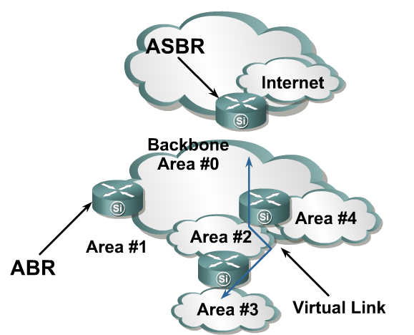
OSPFv3—Hierarchical Structure
Topology of an area is invisible from outside of the area:
LSA flooding is bounded by area.
SPF calculation is performed separately for each area.
Backbones must be contiguous.
All areas must have a connection to the backbone:
Otherwise a virtual link must be used to connect to the backbone.
Notes:
OSPFv3, which is described in RFC 2740, supports IPv6.
OSPF is a routing protocol for IP. It is a link-state protocol. A link-state protocol makes its routing decisions based on the states of the links that connect source and destination machines.
The state of a link is a description of that interface and its relationship to its neighboring networking devices. The interface information includes the IPv6 prefix of the interface, the network mask, the type of network it is connected to, the routers connected to that network, and so on.
This information is propagated in various types of link-state advertisements (LSAs). A router’s collection of LSA data is stored in a link-state database (LSDB). The contents of the database, when subjected to Dijkstra’s algorithm, result in the creation of the OSPF routing table.
The difference between the database and the routing table is that the database contains a complete collection of raw data; the routing table contains a list of shortest paths to known destinations via specific router interface ports.

Slide 12
OSPFv3—Similarities with OSPFv2
OSPFv3 is OSPF for IPv6 (RFC 2740):
Based on OSPFv2, with enhancements
Distributes IPv6 prefixes
Runs directly over IPv6
OSPFv3 & v2 can be run concurrently, because each address family has a separate SPF (ships in the night).
OSPFv3 uses the same basic packet types as OSPFv2:
Hello
Database description blocks (DDB)
Link state request (LSR)
Link state update (LSU)
Link state acknowledgement (ACK)
Notes:
Although most of the algorithms of OSPFv2 are the same in OSPFv3, some changes have been made in OSPFv3, particularly to handle the increased address size in IPv6 and the fact that OSPF runs directly over IP.
Other similarities to OSPFv2 include:
OSPFv3 uses the same basic packet types as OSPFv2, such as hello, database description (DBD) (also called database description packets [DDP]), link-state request (LSR), link-state update (LSU), and LSA.
Mechanisms for neighbor discovery and adjacency formation are identical.
Operations of OSPFv3 over the RFC-compliant nonbroadcast multiaccess (NBMA) and point-to-multipoint topology modes are supported. OSPFv3 also supports the other modes from Cisco such as point-to-point and broadcast including the interface.
LSA flooding and aging are the same for both OSPFv2 and OSPFv3.

Slide 13
OSPFv3—Similarities with OSPFv2
Neighbor discovery and adjacency formation mechanism are identical.
RFC compliant NBMA and point-to-multipoint topology modes are supported. Also supports other modes from Cisco such as point-to-point and broadcast, including the interface.
LSA flooding and aging mechanisms are identical.
Notes:
Because OSPFv2 is heavily dependent on the IPv4 address for its operation, changes were necessary in the OSPFv3 protocol to support IPv6, as outlined in RFC 2740 OSPF for IPv6. Some of the notable changes include platform-independent implementation, protocol processing per-link rather than per-node processing, explicit support for multiple instances per link, and changes in authentication and packet format.
IPv6 OSPF is now an Internet Engineering Task Force (IETF) proposed standard. Like RIPng, IPv6 OSPFv3 uses IPv6 for transport and uses link-local addresses as source address.
All of OSPF for IPv4 optional capabilities, including on-demand circuit support, not-so-stubby areas (NSSAs), and the extensions to Multicast OSPF (MOSPF), are also supported in OSPF for IPv6.

Slide 14
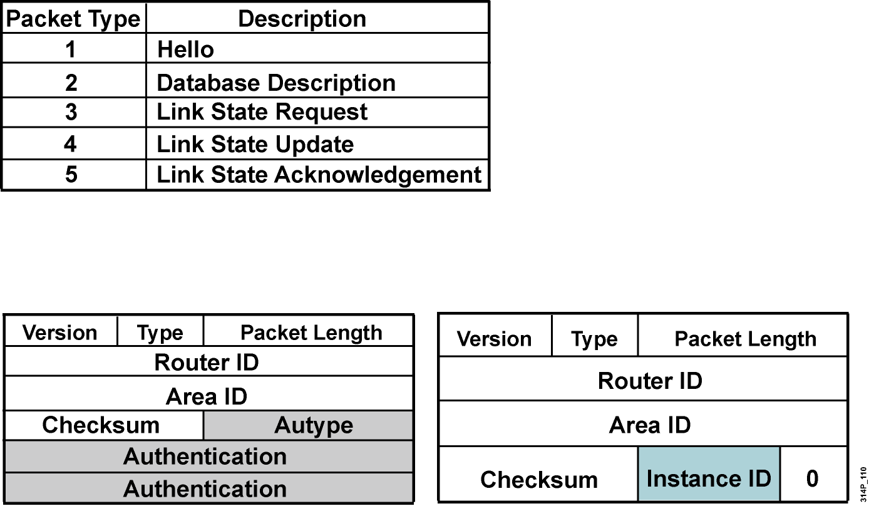
Enhanced Routing Protocol Support Differences from OSPFv2
OSPFv3 has the same five packet types, but some fields have been changed.
All OSPFv3 packets have a 16-byte header verses the 24-byte header in OSPFv2.
Notes:
OSPFv2 was primarily concerned with the subnet on which it was operating, whereas OSPFv3 is concerned with the links to which the router is connected.
OSPFv2 did not define or allow for multiple instances per link, although similar functionality could be made by other mechanisms such as subinterfaces. OSPFv3 has explicit support for instances through the instance field.
Authentication is no longer part of OSPF; it is now the job of IPv6 to make sure the right level of authentication is in use.

Slide 15
OSPFv3—Differences from OSPFv2
OSPFv3 protocol processing per-link, not per-subnet:
IPv6 connects interfaces to links.
Multiple IPv6 subnets can be assigned to a single link.
Two nodes can talk directly over a single link, even though they do not share a common subnet.
The terms “network” and “subnet” are being replaced with “link”.
An OSPF interface now connects to a link instead of a subnet.
Notes:
OSPFv3 runs over a link: The network statement in the router subcommand mode of OSPFv2 is replaced by an OSPFv3 command to apply to the interface configuration. It is possible to have multiple instances per link.
Link-local address: OSPFv3 uses IPv6 link-local addresses to identify the OSPFv3 adjacency neighbors

Slide 16
OSPFv3—Differences from OSPFv2
Multiple OSPFv3 protocol instances can now run over a single link:
This allows for separate autonomous systems, each running OSPF, to use a common link. A single link could belong to multiple areas.
Instance ID is a new field that is used to have multiple OSPFv3 protocol instances per link.
In order to have two instances talk to each other, they need to have the same instance ID. By default it is 0, and for any additional instance it is increased.
Notes:
IPv6 uses the term “link” to indicate “a communication facility or medium over which nodes can communicate at the link layer.”
Interfaces connect to links. Multiple IP subnets can be assigned to a single link, and two nodes can talk directly over a single link, even if they do not share a common IP subnet (IPv6 prefix). For this reason, OSPF for IPv6 runs per-link instead of the IPv4 behavior of per-IP-subnet. The terms network and subnet used in the IPv4 OSPF specification should generally be replaced by link. Likewise, an OSPF interface now connects to a link instead of an IP subnet, etc.
This change affects the receiving of OSPF protocol packets, and the contents of hello packets and network LSAs.

Slide 17
OSPFv3—Differences from OSPFv2
Multicast addresses:
FF02::5 – Represents all SPF routers on the link local scope; equivalent to 224.0.0.5 in OSPFv2.
FF02::6 – Represents all DR routers on the link local scope; equivalent to 224.0.0.6 in OSPFv2.
Removal of address semantics:
IPv6 addresses are no longer present in OSPF packet header (part of payload information).
Router LSA and network LSA do not carry IPv6 addresses.
Router ID, area ID, and link-state ID remains at 32 bits.
DR and BDR are now identified by their router ID and no longer by their IP address.
Security:
OSPFv3 uses IPv6 AH and ESP extension headers instead of variety of mechanisms defined in OSPFv2.
Notes:
Differences from OSPFv2 include the following:
Multicast addresses:
FF02::5 – Represents all shortest path first (SPF) routers on the link-local scope, equivalent to 224.0.0.5 in OSPFv2.
FF02::6 – Represents all designated routers (DRs) on the link-local scope, equivalent to 224.0.0.6 in OSPFv2.
Removal of address semantics:
IPv6 addresses are no longer present in the OSPF packet header (part of payload information).
Router LSAs and network LSAs do not carry IPv6 addresses.
Router ID, area ID and link-state ID remains at 32 bits.
DR and backup designated router (BDR) are now identified by their router ID and no longer by their IP address.
Security:
OSPFv3 uses IPv6 Authentication Header (AH) and Encapsulating Security Payload (ESP) extension headers instead of the variety of mechanisms defined in OSPFv2.

Slide 18
LSA Overview
 | LSA Function Code | LSA Type
Router-LSA | 1 | Ox2001
Network-LSA | 2 | Ox2002
Inter-Area-Prefix-LXA | 3 | Ox2003
Inter-Area-Router-LSA | 4 | Ox2004
AS-External-LSA | 5 | Ox4005
Group-Membership-LSA | 6 | Ox2006
Type-7-LSA | 7 | Ox2007
Link-LSA | 8 | Ox2008
Intra-Area-Prefix-LSA | 9 | Ox2009
Renamed
New
Notes:
OSPFv3 LSA features include:.
The LSA is composed of a router ID, area ID, and link-state ID. They are each 32 bits and are not derived from an IPv4 address.
Router LSAs and network LSAs contain only 32-bit IDs. They do not contain addresses.
LSAs have flooding scopes that define a diameter that they should be flooded to, as follows:
Link-local (flood all routers on-link)
Area (flood all routers within an OSPF area)
Autonomous system (AS) (flood all routers within the entire OSPF AS)
OSPFv3 supports the forwarding of unknown LSAs based on the flooding scope. This can be useful in an NSSA.
OSPFv3 now takes advantage of IPv6 multicasting, using FF02::5 for all OSPF routers and FF02::6 for the OSPF designated router and the OSPF BDR.
The two renamed LSAs are as follows:
Interarea prefix LSAs for area border routers (ABRs) (type 3): Type 3 LSAs advertise internal networks to routers in other areas (interarea routes). Type 3 LSAs may represent a single network or a set of networks summarized into one advertisement. Only ABRs generate summary LSAs. In OSPF for IPv6, addresses for these LSAs are expressed as prefix, prefix length instead of address, mask. The default route is expressed as a prefix with length 0.
Interarea router LSAs for Autonomous System Boundary Routers (ASBRs) (type 4): Type 4 LSAs advertise the location of an ASBR. Routers that are trying to reach an external network use these advertisements to determine the best path to the next hop. ASBRs generate type 4 LSAs.
The two new LSAs in IPv6 are as follows:
Link LSAs (type 8): Type 8 LSAs have link-local flooding scope and are never flooded beyond the link with which they are associated. Link LSAs provide the link-local address of the router to all other routers attached to the link, inform other routers attached to the link of a list of IPv6 prefixes to associate with the link, and allow the router to assert a collection of options bits to associate with the network LSA that will be originated for the link.
Intra-area prefix LSAs (type 9): A router can originate multiple intra-area prefix LSAs for each router or transit network, each with a unique link-state ID. The link-state ID for each intra-area prefix LSA describes its association to either the router LSA or the network LSA. The link-state ID also contains prefixes for stub and transit networks.

Slide 19
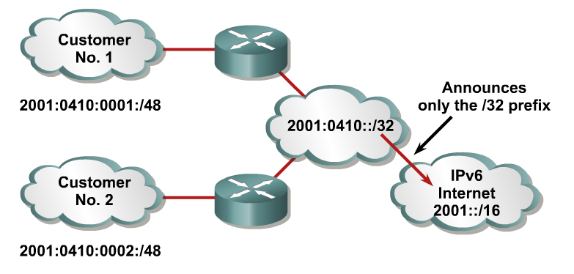
Larger Address Space Enables Address Aggregation
Aggregation of prefixes announced in the global routing table
Efficient and scalable routing
Improved bandwidth and functionality for user traffic
Notes:
An address prefix occurs in almost all newly defined LSAs. The prefix is represented by the following three fields: Prefix Length, Prefix Options, and Address Prefix.
In OSPF for IPv6, addresses for these LSAs are expressed as prefix, prefix length instead of address, mask.
The default route is expressed as a prefix with length 0.
Type 3 and type 9 LSAs carry all IPv6 prefix information, which, in IPv4, is included in router LSAs and network LSAs.

Slide 20
Self Check
Can OSPFv3 and v2 run concurrently?
List some similarities between OSPFv3 and OSPFv2.
Explain the difference between OSPFv3 and OSPFv2 in terms of links or subnets.
What is Instance ID?
Notes:
Yes. OSPFv3 & v2 can be run concurrently, because each address family has a separate SPF.
Neighbor discovery and adjacency formation mechanism are identical. OSPFv3 uses the same basic packet types as OSPFv2. LSA flooding and aging mechanisms are identical.
OSPFv3 protocol processing per-link, not per-subnet. OSPFv2 was primarily concerned with the subnet on which it was operating, whereas OSPFv3 is concerned with the links to which the router is connected. OSPFv2 did not define or allow for multiple instances per link, although similar functionality could be made by other mechanisms such as subinterfaces. OSPFv3 has explicit support for instances through the instance field.
Instance ID is a new field that is used to have multiple OSPFv3 protocol instances per link. In order to have two instances talk to each other, they need to have the same instance ID. By default it is 0, and for any additional instance it is increased.

Slide 21
OSPFv3 Configuration

Slide 22
Configuring OSPFv3 in Cisco IOS Software
Similar to OSPFv2:
Prefixing existing Interface and exec mode commands with “ipv6”
Interfaces configured directly:
Replaces network command
“Native” IPv6 router mode:
Not a submode of router ospf command
Notes:
OSPFv3 has the following Cisco IOS attributes:
Network area command: The way to identify IPv6 networks that are part of the OSPFv3 network is different than with OSPFv2 configuration. The network area command in OSPFv2 is replaced by a configuration in which interfaces are directly configured to specify that IPv6 networks are part of the OSPFv3 network.
Native IPv6 router mode: The configuration of OSPFv3 is not a subcommand mode of the router ospf command (as it is in OSPFv2 configuration).

Slide 23
IPv6 and OSPFv3 Commands
Command | Description
Router(config)#ipv6 unicast-routing | Enables the forwarding of IPv6 unicast datagrams.
Router(config)#ipv6 router ospf process-id | Enables an OSPF process on the router. The process-id parameter identifies a unique OSPFv3 process. This command is used on a global basis.
Example: Router(config)#ipv6 router ospf 1 | Enables the OSPFv3 process number 1 on the router.
Router (config-router)# router-id router-id | For an IPv6-only router, a router-id parameter must be defined in the OSPFv3 configuration as an IPv4 address using the router-id router-id command. You can use any IPv4 address as the router-id value.
Example: Router (config-router)# router-id 2.2.2.2 | Identifies 2.2.2.2 as the router-id for this router. It must be unique on each router
Notes:
Routing of IPv6 unicast datagrams is disabled by default. To enable forwarding of IPv6 unicast datagrams, use the ipv6 unicast-routing command in global configuration mode.
Identify an OSPF process on the router using the ipv6 router ospf process-id command in global configuration mode. The process-id is an internal identification. It is locally assigned and can be a positive integer from 1 to 65535. The number used here is the number assigned administratively when enabling the OSPF for IPv6 routing process.

Slide 24
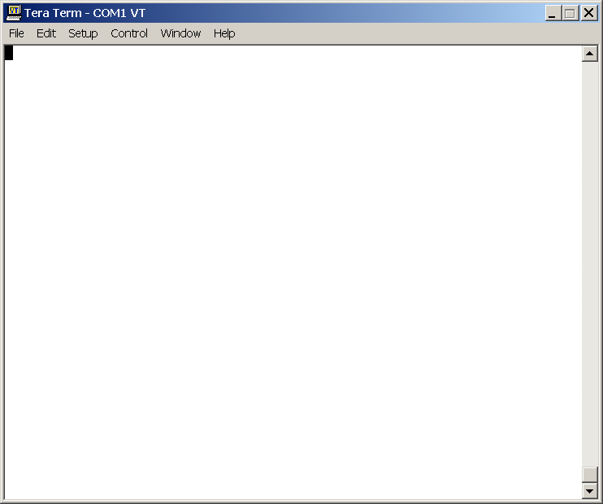
Enabling OSPFv3 Globally
router#
router# configure terminal
router(config)# ipv6 unicast-routing
router(config)# ipv6 router ospf 1
router(config-router) router-id 2.2.2.2
Notes:
This example shows the router commands for enabling OSPF globally:
The forwarding of IPv6 datagrams is enabled using the unicast-routing command.
The OSPF process is started with process ID 1.
The router is given router ID 2.2.2.2

Slide 25
Steps for Enabling IPv6 and OSPFv3 on an Interface
Step | Command or Action | Purpose
1 | Router(config)#interface type number | Specifies an interface type and number, and places the router in interface configuration mode.
2 | Router(config-if)#ipv6 address address/prefix-length [eui-64] | Configures an IPv6 address for an interface and enables IPv6 processing on the interface. The eui-64 parameter forces the router to complete the addresses’ low-order 64-bits by using an EUI-64 interface ID.
3 | Router(config-if)#ipv6 ospf process-id area area-id [instance instance-id] | Enables OSPF for IPv6 on an interface.
4 | Router(config-if)#router ospf priority priority number | Priority number is used in the designated router election.
5 | Router(config-if)#router ospf cost cost | The cost of sending a packet on the interface, expressed in the link state metric.
Notes:
To enable IPv6 for OSPFv3 on an interface:
Enter interface configuration mode
Assign an IPv6 address for the interface. This enables IPv6 processing on the interface. The [eui-64] parameter creates an IPv6 address using the interface ID. Configures site-local and global IPv6 addresses with an interface identifier (ID) in the low-order 64 bits of the IPv6 address. Only the 64-bit network prefix for the address needs to be specified; the last 64 bits are automatically computed from the interface ID.
Enable OSPF for IPv6 on the interface using the ipv6 ospf process-id area area-id [instance instance-id] command. An OSPF instance (also known as an OSPF process) can be considered a logical router running OSPF in a physical router. Use the instance ID to control selection of other routers as your neighbors. You become neighbors only with routers that have the same instance ID.
To set the router priority, which helps determine the designated router for this network, use the ipv6 ospf priority command. To return to the default value, use the no form of this command.
To explicitly specify the cost of sending a packet on an interface, use the ipv6 ospf cost command. You can set the metric manually using this command, if you need to change the default.

Slide 26
Enabling OSPFv3 on an Interface
router(config)# interface Ethernet0/0
router(config)# ipv6 address 3FFE:FFFF:1::1/64
router(config)# ipv6 ospf 1 area 0
router(config)# ipv6 ospf priority 20
router(config)# ipv6 ospf cost 20
Notes:
This example shows a configuration for IPv6 on the Ethernet 0/0 interface:
Enter interface configuration mode
IPv6 address is configured for the interface: 3FFE:FFFF:1::1/64
OSPF for IPv6 is enabled on the interface for OSPF process 1, area 0.
The router priority is set to 20.
OSPF cost is set to 20.

Slide 27
Cisco IOS OSPFv3 Specific Attributes
Configuring area range:
area area-id range prefix/prefix length [advertise | not-advertise] [cost cost]
Showing new LSAs:
show ipv6 ospf [process-id] database link
show ipv6 ospf [process-id] database prefix
Notes:
To consolidate and summarize routes at an area boundary use the IPv6 OSPF router command:
area area-id range ipv6-prefix/ prefix-length [advertise | not-advertise] [cost cost].
For example:
Router(config)#ipv6 router ospf 1
Router(config-rtr)#area range 1 2001:0DB8::/48
The cost of the summarized routes will be the highest cost of the routes being summarized. For example, if the following routes are summarized:
OI 2001:0DB8:0:0:7::/64 [110/20]
via FE80::A8BB:CCFF:FE00:6F00, Ethernet0/0
OI 2001:0DB8:0:0:8::/64 [110/100]
via FE80::A8BB:CCFF:FE00:6F00, Ethernet0/0
OI 2001:0DB8:0:0:9::/64 [110/20]
via FE80::A8BB:CCFF:FE00:6F00, Ethernet0/0
They become one summarized route, as follows:
OI 2001:0DB8::/48 [110/100]
via FE80::A8BB:CCFF:FE00:6F00, Ethernet0/0

Slide 28
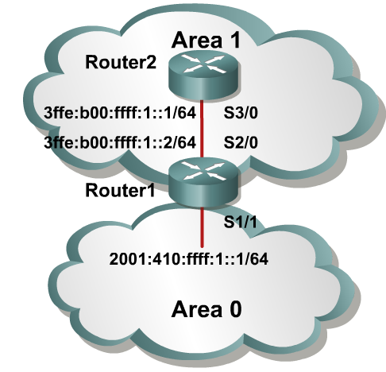
OSPFv3 Configuration Example
Router1#
interface S1/1
ipv6 address 2001:410:FFFF:1::1/64
ipv6 ospf 100 area 0
interface S2/0
ipv6 address 3FFE:B00:FFFF:1::2/64
ipv6 ospf 100 area 1
ipv6 router ospf 100
router-id 10.1.1.3
Router2#
interface S3/0
ipv6 address 3FFE:B00:FFFF:1::1/64
ipv6 ospf 100 area 1
ipv6 router ospf 100
router-id 10.1.1.4
Notes:
The example shows an OSPF network of two routers, with an area 0 and area 1.
The interface-specific command ipv6 ospf 100 area 0 will create the “ipv6 router ospf 100” process dynamically, as will the ipv6 ospf 100 area 1 command.

Slide 29
Self Check
How is the network area command handled in OSPFv3?
What is the default setting for routing of IPv6 unicast datagrams?
What command is used to enable forwarding of IPv6 unicast datagrams?
How do you control selection of other routers as your neighbors?
Notes:
The way to identify IPv6 networks that are part of the OSPFv3 network is different than with OSPFv2 configuration. The network area command in OSPFv2 is replaced by a configuration in which interfaces are directly configured to specify that IPv6 networks are part of the OSPFv3 network.
Routing of IPv6 unicast datagrams is disabled by default.
To enable forwarding of IPv6 unicast datagrams, use the ipv6 unicast-routing command in global configuration mode.
Use the instance ID to control selection of other routers as your neighbors. You become neighbors only with routers that have the same instance ID.

Slide 30
OSPFv3 Verification

Slide 31
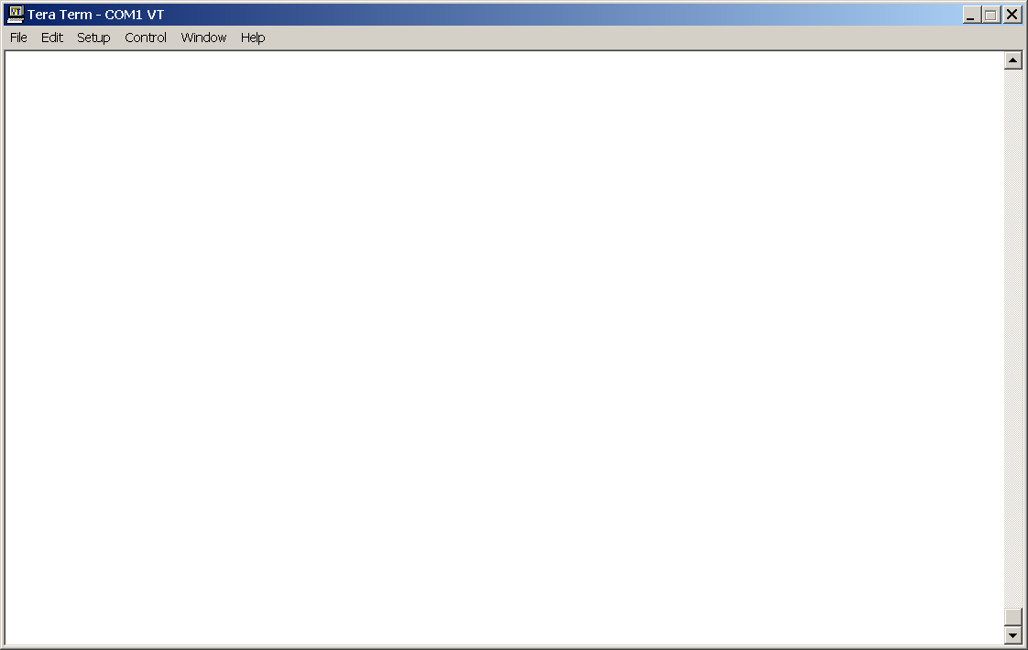
Verifying Cisco IOS OSPFv3
Router2#show ipv6 ospf int s 3/0
S3/0 is up, line protocol is up
Link Local Address 3FFE:B00:FFFF:1::1, Interface ID 7
Area 1, Process ID 100, Instance ID 0, Router ID 10.1.1.4
Network Type POINT_TO_POINT, Cost: 1
Transmit Delay is 1 sec, State POINT_TO_POINT,
Timer intervals configured, Hello 10, Dead 40, Wait 40, Retransmit 5
Hello due in 00:00:02
Index 1/1/1, flood queue length 0
Next 0x0(0)/0x0(0)/0x0(0)
Last flood scan length is 3, maximum is 3
Last flood scan time is 0 msec, maximum is 0 msec
Neighbor Count is 1, Adjacent neighbor count is 1
Adjacent with neighbor 10.1.1.3
Suppress hello for 0 neighbor(s)
Notes:
There are several commonly used OSPFv3 show commands, including the show ipv6 ospf [process-id][area-id] interface [interface] command. This command displays OSPF-related interface information, as displayed in the figure.
The clear ipv6 ospf [ process-id] {process |force-spf | redistribution | counters [neighbor[ neighbor-interface | neighbor-id]]} command triggers SPF recalculation and repopulation of the Routing Information Base (RIB).
Displays information about the OSPF process on this interface:
Status of the physical link and operational status of protocol.
Interface IPv6 address.
The area ID, process ID, instance ID, and router ID of the area from which this route is learned.
Network type and link-state cost.
Transmit delay, interface state, and router priority.
Designated router ID and respective interface IP address.
Backup designated router ID and respective interface IP address.
Configuration of timer intervals.
Number of seconds until the next hello packet is sent out this interface.
Count of network neighbors and list of adjacent neighbors.

Slide 32
show ipv6 ospf
R7#show ipv6 ospf
Routing Process “ospfv3 1” with ID 75.0.7.1
It is an area border and autonomous system boundary router
Redistributing External Routes from, connected
SPF schedule delay 5 secs, Hold time between two SPFs 10 secs
Minimum LSA interval 5 secs. Minimum LSA arrival 1 secs
LSA group pacing timer 240 secs
Interface floor pacing timer 33 msecs
Retransmission pacing timer 33 msecs
Number of external LSA 3. Checksum Sum 0x12B75
Notes:
Process ID and OSPF router ID.
Configured LSA group pacing timer (in seconds).
Configured LSA flood pacing timer (in milliseconds).
Configured LSA retransmission pacing timer (in milliseconds).
Number of areas in router, area addresses, etc.

Slide 33
show ipv6 ospf (Cont.)
Number of areas in this router is 2. 1 normal 0 stub 1 nssa
Area BACKBONE(0)
Number of interfaces in this area is 1
SPF algorithm executed 23 times
Number of LSA 14. Checksum Sum 0x760AA
Number of DCbitless LSA 0
Number of Indication LSA 0
Number of DoNotAge LSA 0
Flood list length 0
Area 2
Number of interfaces in this area is 1
It is a NSSA area
Perform type-7/type-5 LSA translation
SPF algorithm executed 17 times
Number of LSA 25. Checksum Sum 0xE3BF0
Number of DCbitless LSA 0
Number of Indication LSA 0
Number of DoNotAge LSA 0

Slide 34
show ipv6 ospf neighbor detail
Router2#show ipv6 ospf neighbor detail
Neighbor 10.1.1.3
In the area 0 via interface S2/0
Neighbor: interface-id 14, link-local address 3FFE:B00:FFFF:1::2
Neighbor priority is 1, State is FULL, 6 state changes
Options is 0x63AD1B0D
Dead timer due in 00:00:33
Neighbor is up for 00:48:56
Index 1/1/1, retransmission queue length 0, number of retransmission 1
First 0x0(0)/0x0(0)/0x0(0) Next 0x0(0)/0x0(0)/0x0(0)
Last retransmission scan length is 1, maximum is 1
Last retransmission scan time is 0 msec, maximum is 0 msec
Notes:
Some parameters displayed by this command:
Neighbor router ID
Area and interface through which the OSPF neighbor is known
Router priority of the neighbor, neighbor state
OSPF state
Number of state changes since the neighbor was created
Hello packet options field contents
Expected time before Cisco IOS software will declare the neighbor dead
Number of hours:minutes:seconds since the neighbor went into two-way state

Slide 35
show ipv6 ospf database
Router Link States (Area 1)
ADV Router Age Seq# Fragment ID Link count Bits
26.50.0.1 1812 0x80000048 0 1 None
26.50.0.2 1901 0x80000006 0 1 B
Net Link States (Area 1)
ADV Router Age Seq# Link ID Rtr count
26.50.0.1 57 0x8000003B 3 4
Inter Area Prefix Link States (Area 1)
ADV Router Age Seq# Prefix
26.50.0.2 139 0x80000003 3FFE:FFFF:26::/64
26.50.0.2 719 0x80000001 3FFE:FFF:26::/64
Inter Area Router Link States (Area 1)
ADV Router Age Seq# Link ID Dest RtrID
26.50.0.2 772 0x80000001 1207959556 72.0.0.4
26.50.0.4 5 0x80000003 1258292993 75.0.7.1
Notes:
To display lists of information related to the OSPF database for a specific router, use the show ipv6 ospf database command in EXEC mode. The various forms of this command deliver information about different OSPF link-state advertisements (LSAs).

Slide 36
Activity
Lab 8-1 Configuring OSPF for IPv6
Learning Objectives
Configure a static IPv6 address on an interface
Change the default-link local address on an interface
Configure an EUI-64 IPv6 address on an interface
Enable IPv6 routing and CEF
Configure and verify single-area OSPFv3 operation
Notes:
This lab can be performed on NETLAB.
This lab was developed for CCNP v5.0 lab bundle.

Slide 37
Summary
RIP, EIGRP, IS-IS, BGP, and OSPF support IPv6.
OSPFv3 is OSPF for IPv6.
Most of the algorithms of OSPFv2 are the same in OSPFv3.
There are two new LSAs in IPv6: LSA type 8 and LSA type 9. The router LSA and the network LSA do not carry IPv6 addresses.
Configuring OSPFv3 requires knowledge of IPv6.
There are Cisco IOS software configuration commands for OSPFv3 to support all of the capabilities of OSPFv3.
Numerous OSPFv3 IOS show commands support the verification of OSPFv3 configurations.

Slide 38
Q and A

Slide 39
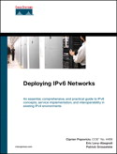
Resources
IPv6 Routing At-A-Glance
http://cisco.com/application/pdf/en/us/guest/tech/tk872/c1482/cdccont_0900aecd80260051.pdf
Deploying IPv6 Networks
By Ciprian P. Popoviciu, Eric Levy-Abegnoli, Patrick Grossetete.
Published by Cisco Press
Copyright 2006

